Slide 1



Slide 2
Suppurative Lung Diseases
By
Mohammad Gamal Abdalrahman
Lecturer of Chest diseases
Faculty of Medicine
Assiut University

Slide 3
Suppurative Lung Diseases
They are group of pulmonary disorders
that characterized by presence of pus
within the lung parenchyma.
1- Bronchiectasis
2- Lung abscess
3- Empyema with broncho-pleural fistula
4- Infected cystic lung

Slide 4
Bronchiectasis

Slide 5
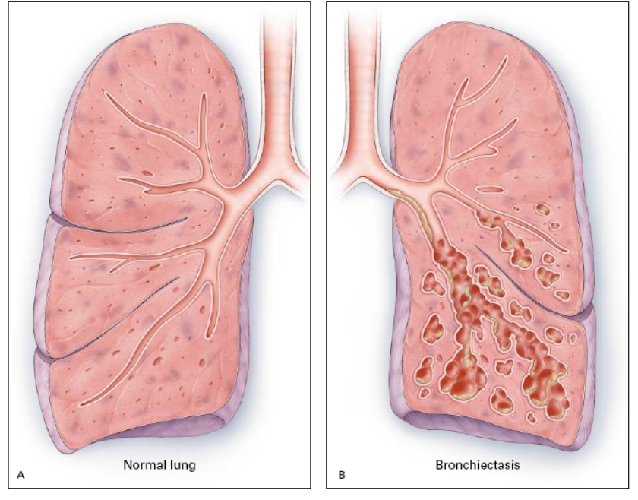
Bronchiectasis
Definition
Bronchiectasis is abnormal permanent dilatation
of one or more bronchi or bronchioles, caused by destruction of muscular and elastic components of the bronchial walls.
Most often secondary to an infectious process.

Slide 6
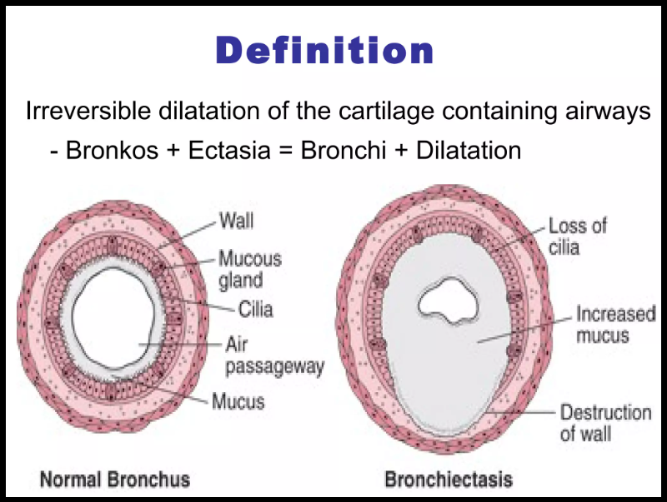

Slide 7
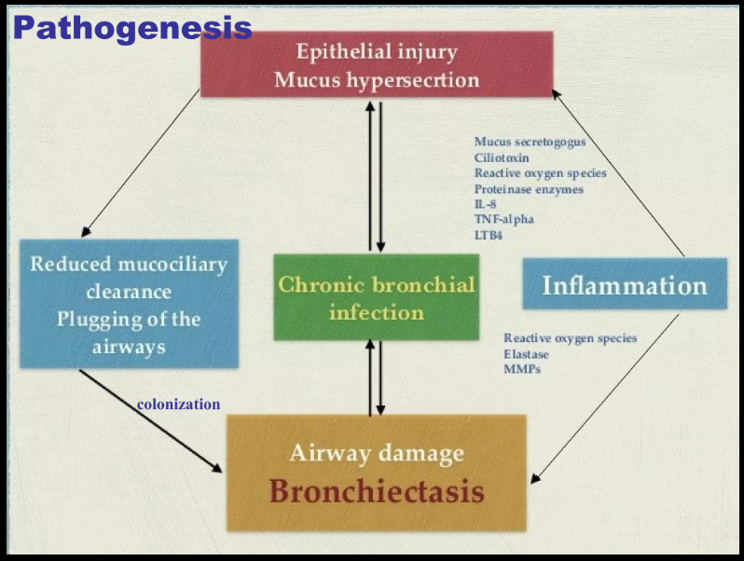

Slide 8
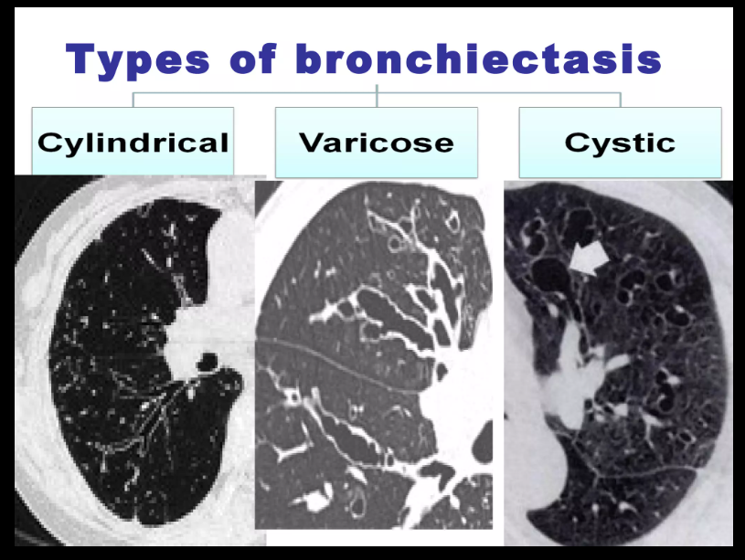

Slide 9
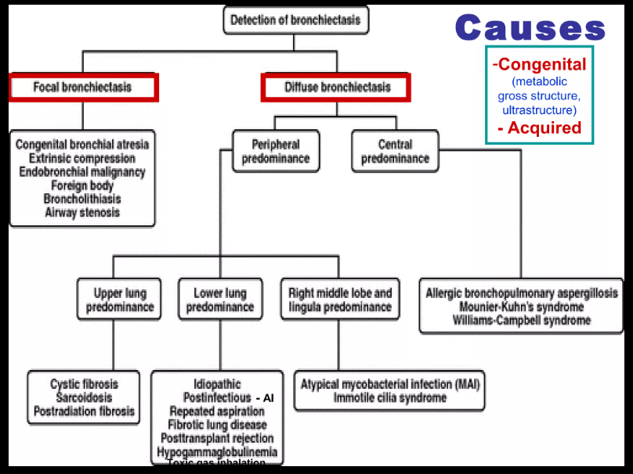

Slide 10
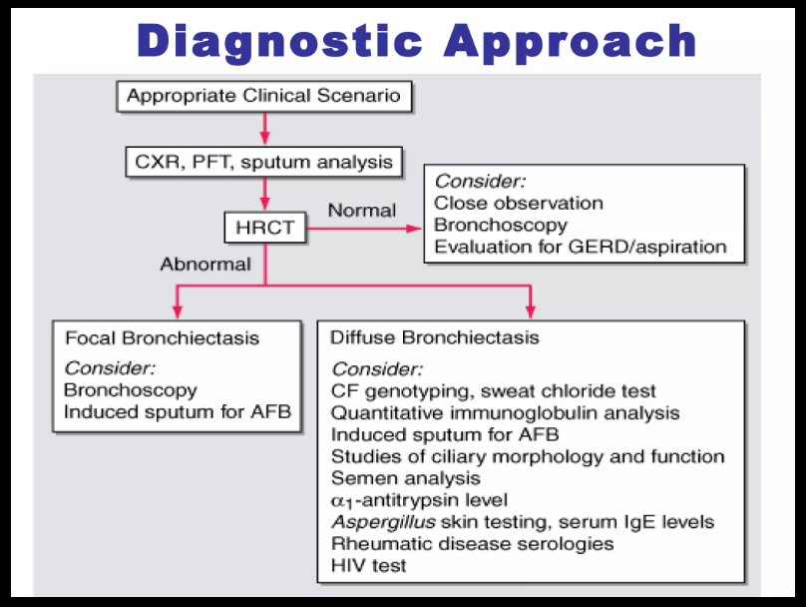

Slide 11
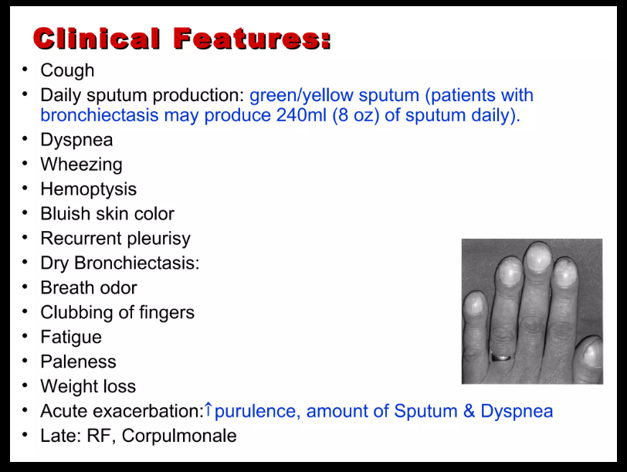

Slide 12
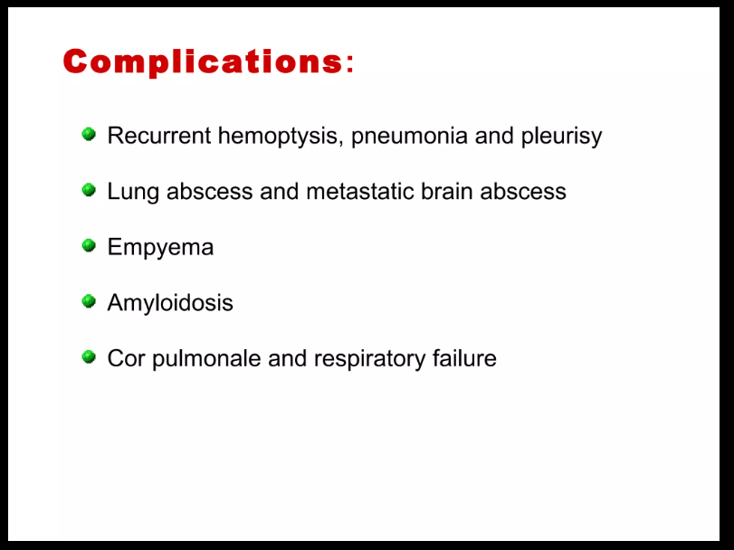

Slide 13
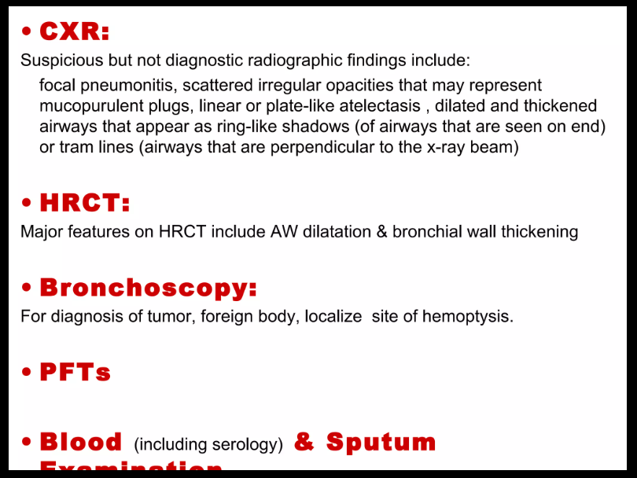

Slide 14
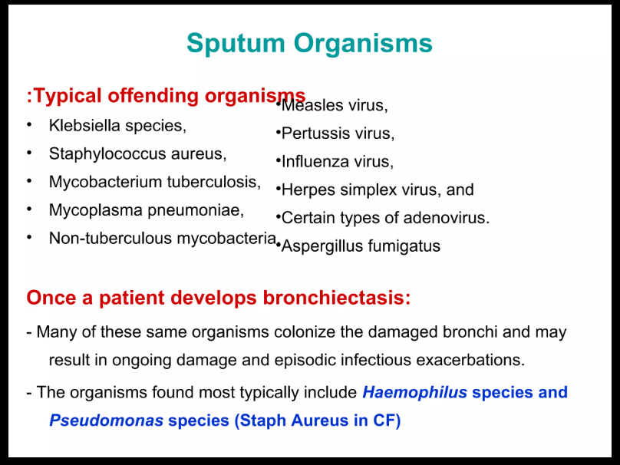

Slide 15
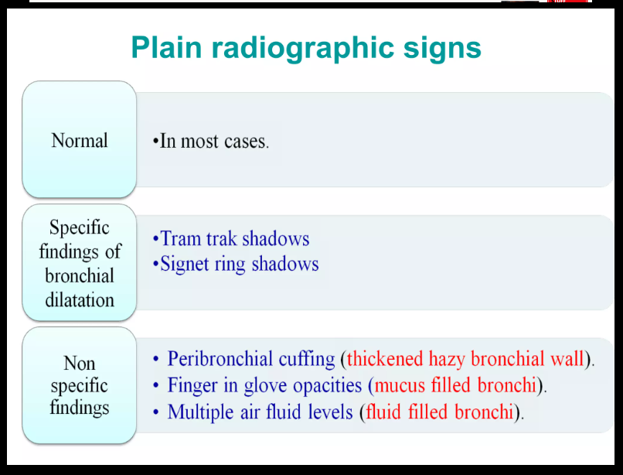

Slide 16
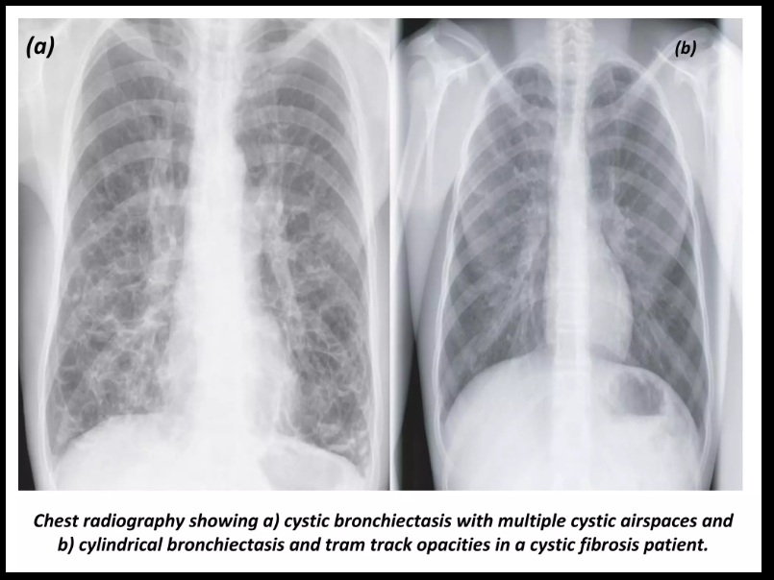

Slide 17
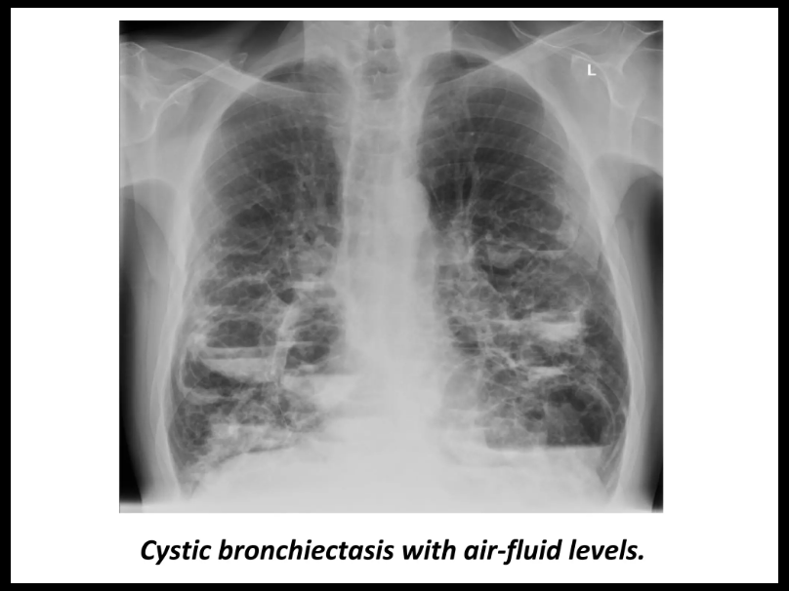

Slide 18
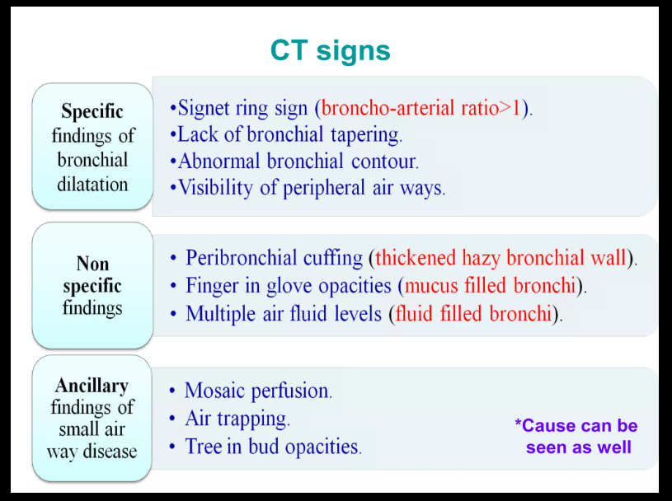

Slide 19
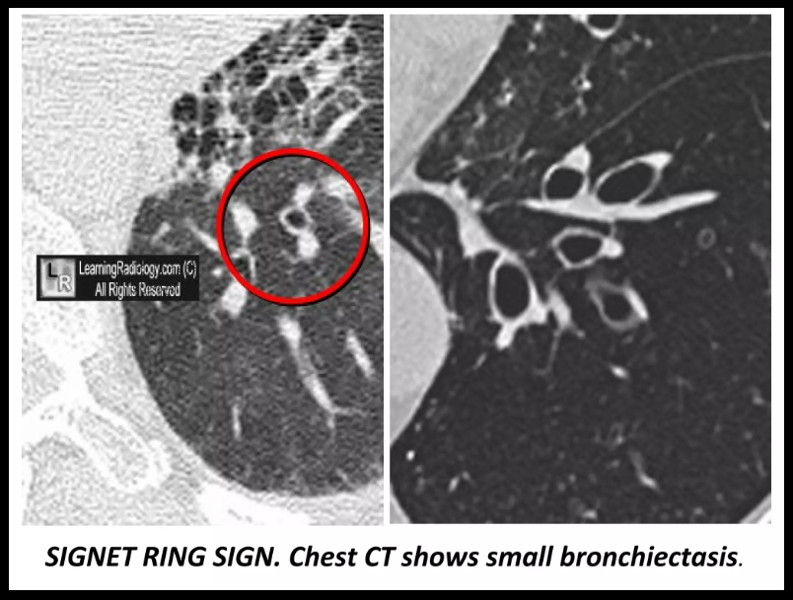

Slide 20
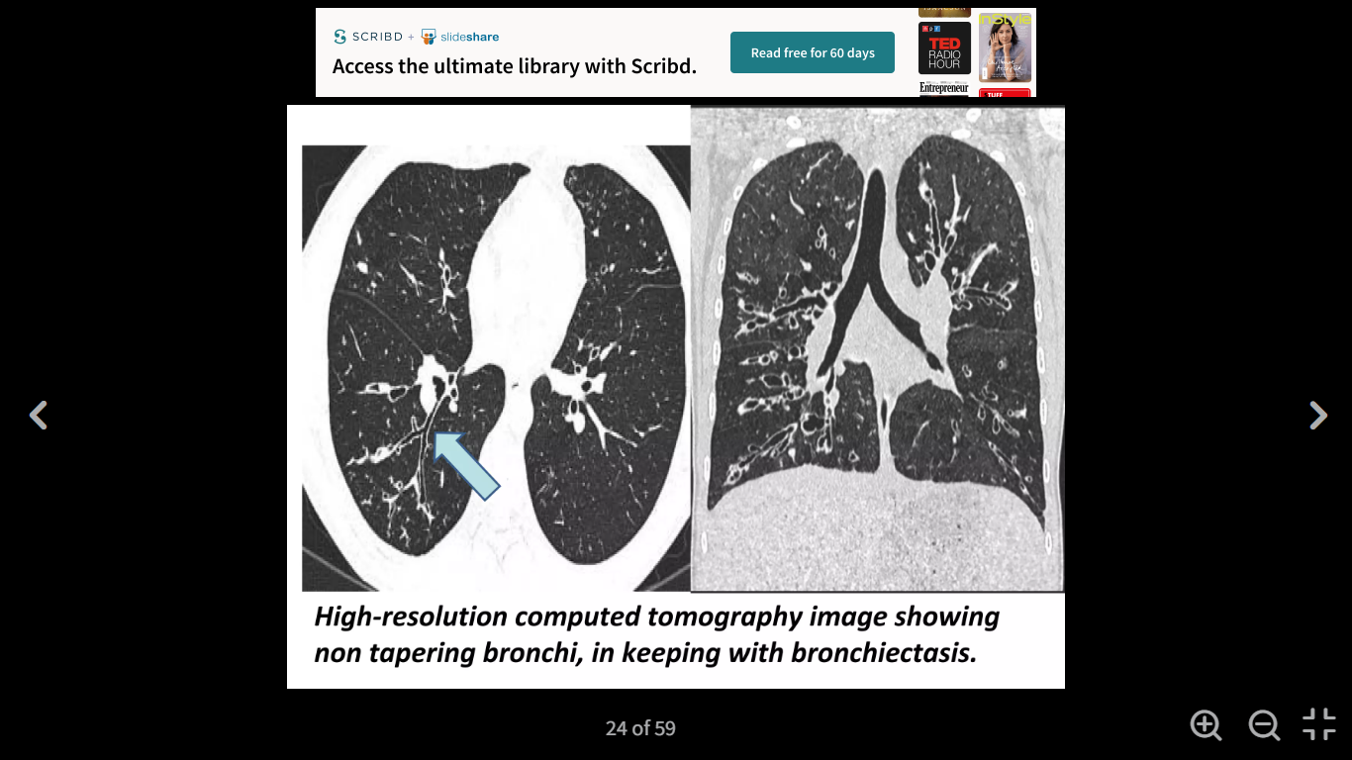

Slide 21
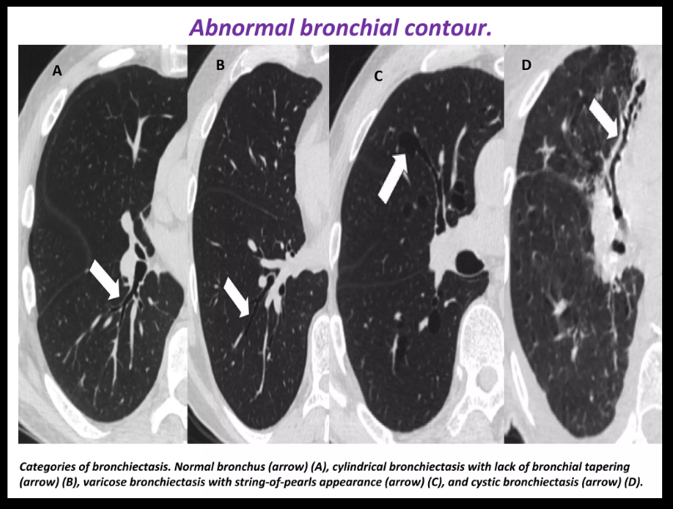

Slide 22
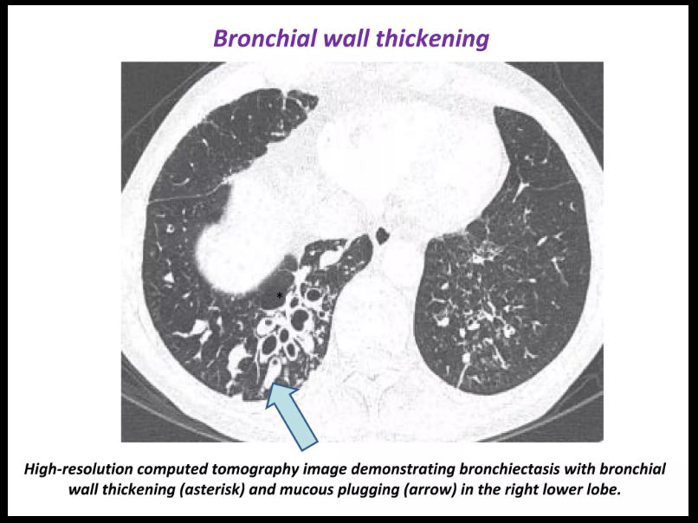

Slide 23
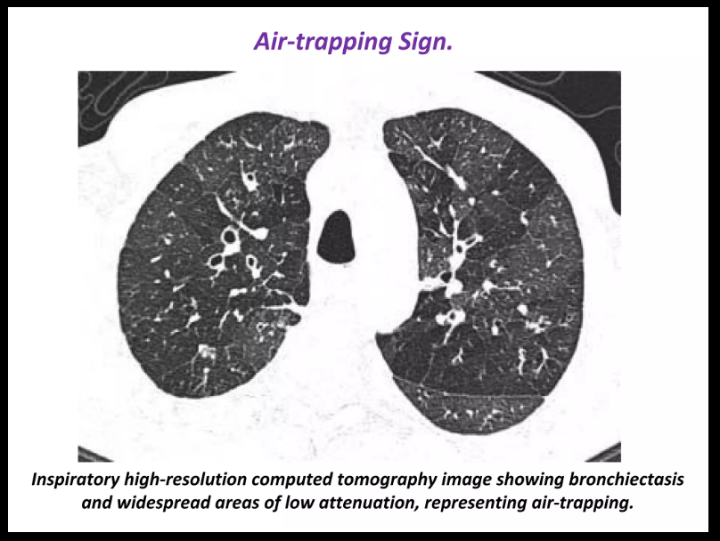

Slide 24
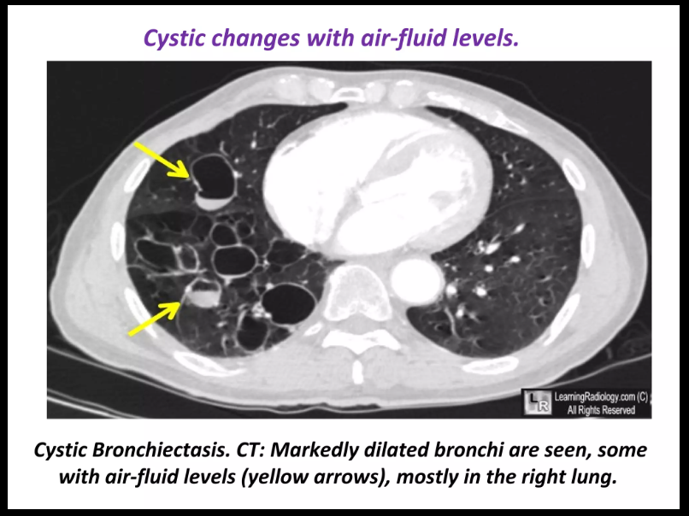

Slide 25
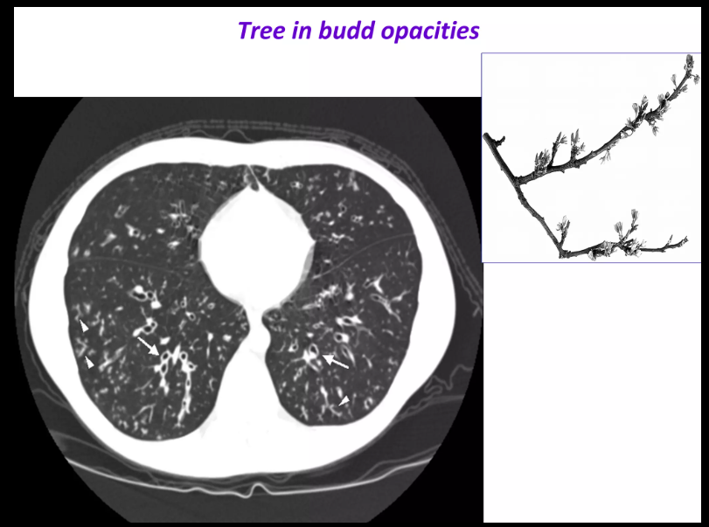

Slide 26
Differential Diagnosis
I) Other causes of chronic airway diseases:
◘ Bronchial asthma
◘ COPD
◘ Chronic bronchitis
II) Other causes of suppurative lung
syndromes:
◘ Empyema with bronchopleural fistula
◘ Chronic lung abscess
III) Other causes of hemoptysis

Slide 27
Treatment Outlines
1- Treatment of pulmonary infections (Antibiotics)
2- Clearance of airway secretions
◘ Bronchodilators ◘ Mucolytics
◘ Mobilization of secretions:
Postural drainage and Chest physiotherapy
3- Surgery
◘ Resection ◘ Transplantation

Slide 28
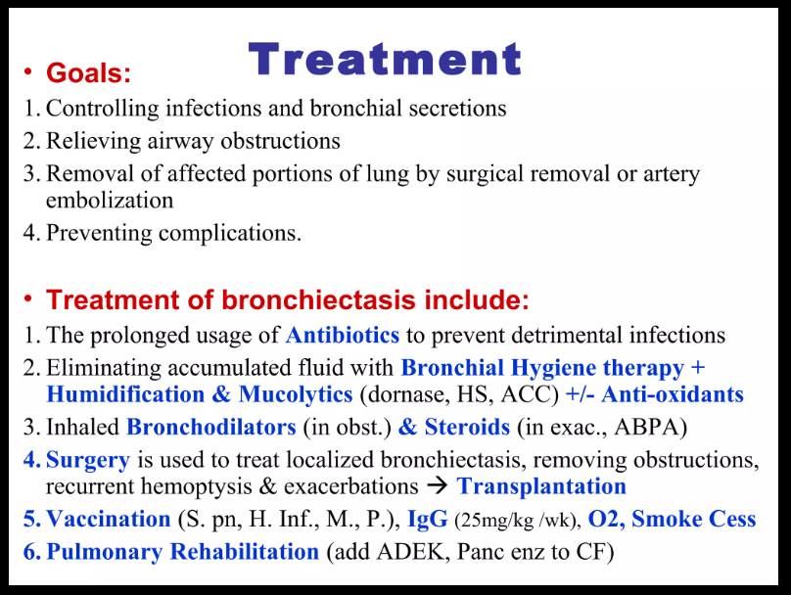

Slide 29
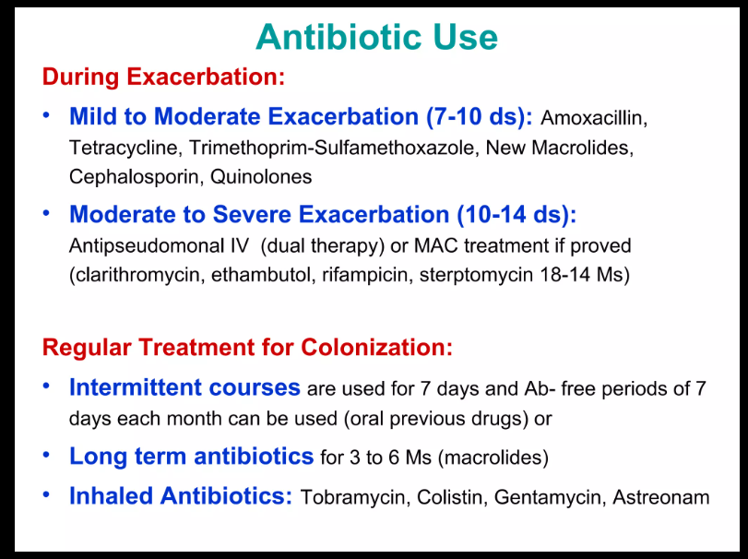

Slide 30
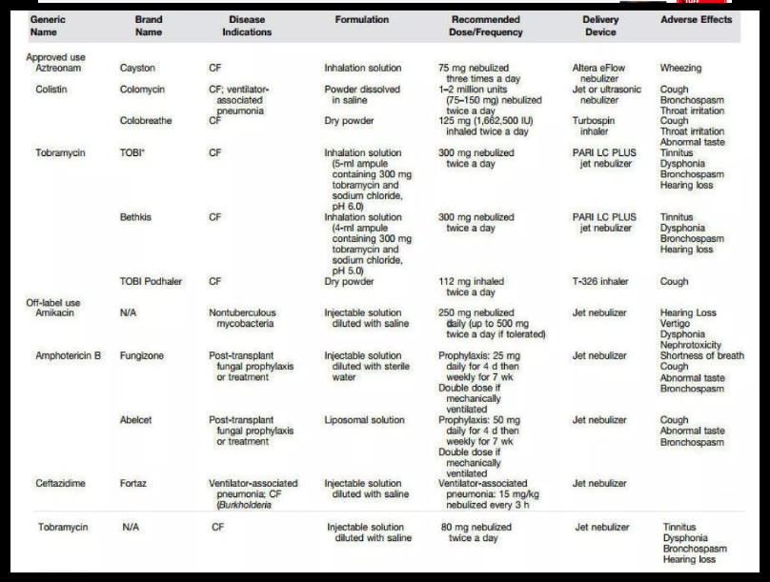

Slide 31
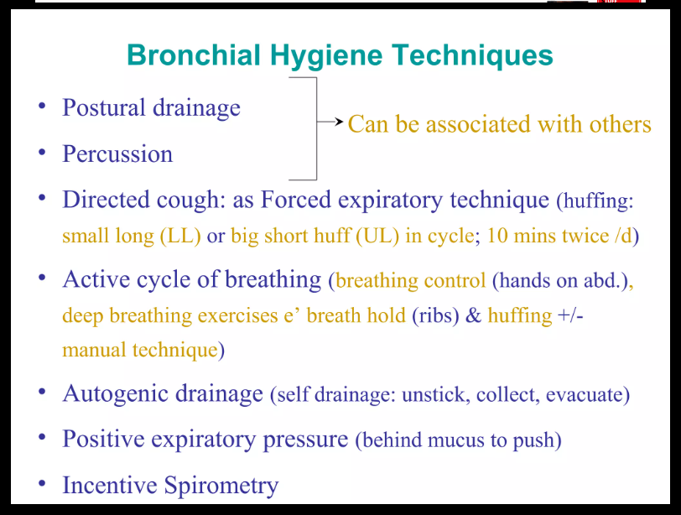

Slide 32
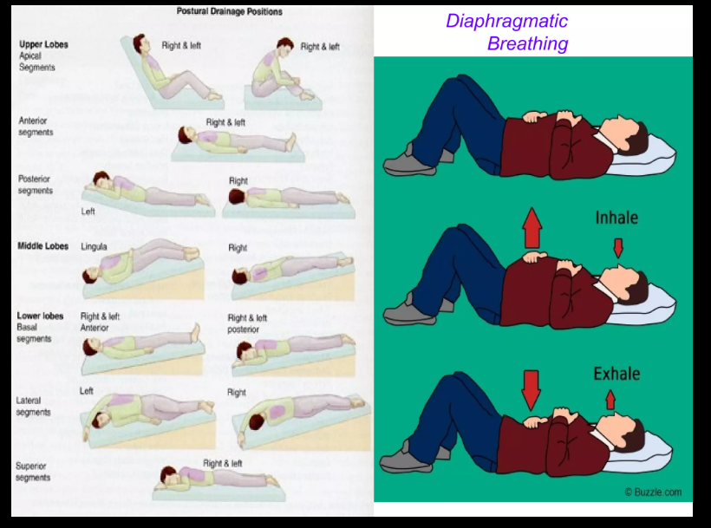

Slide 33
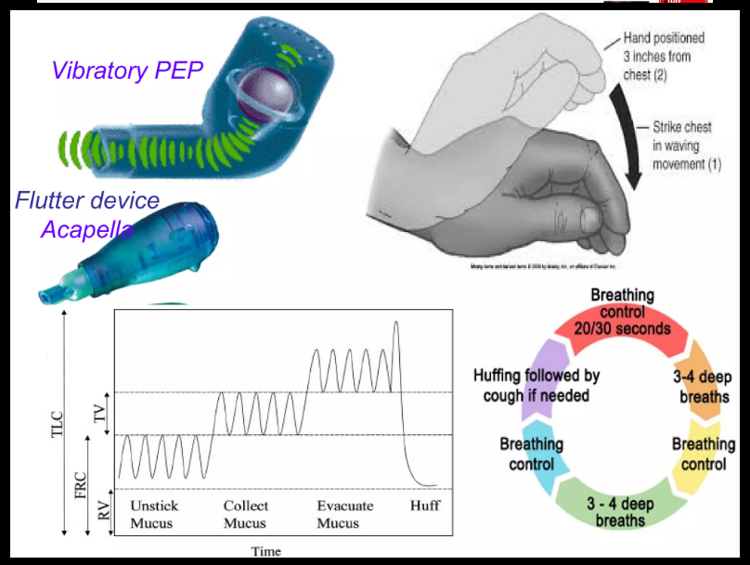

Slide 34
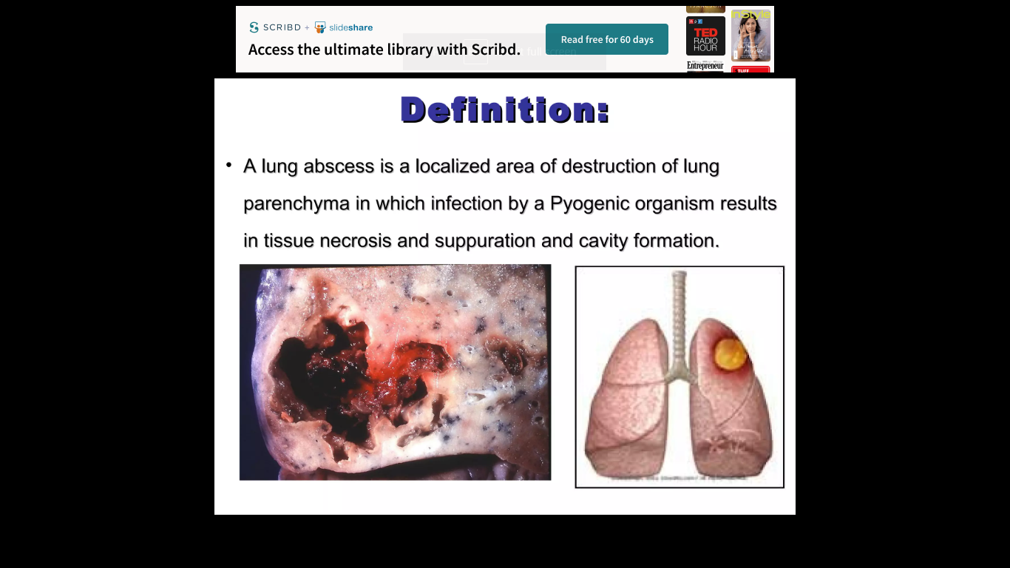
Lung Abscess

Slide 35
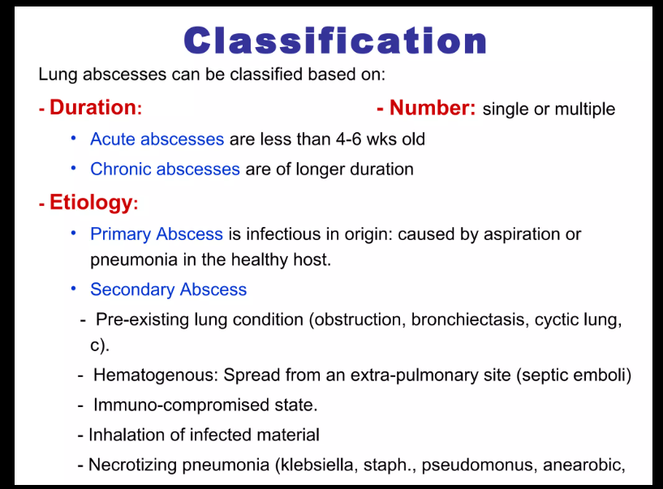

Slide 36
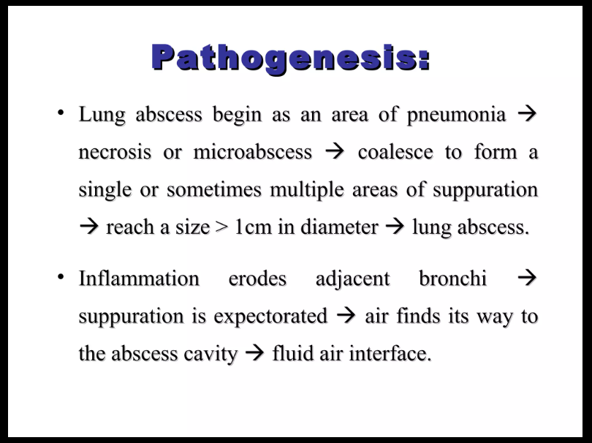

Slide 37
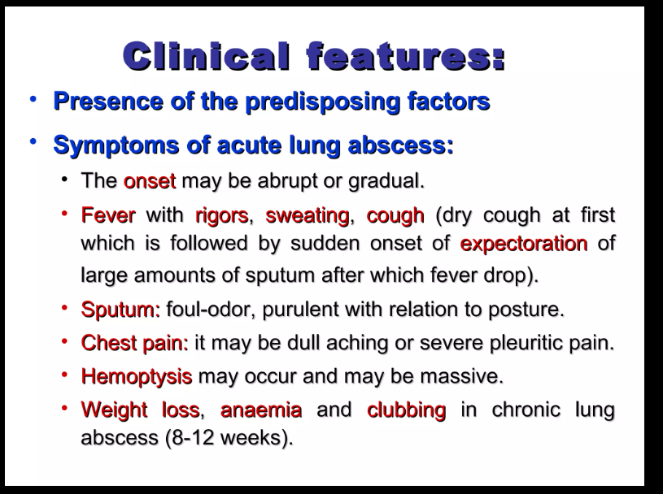

Slide 38
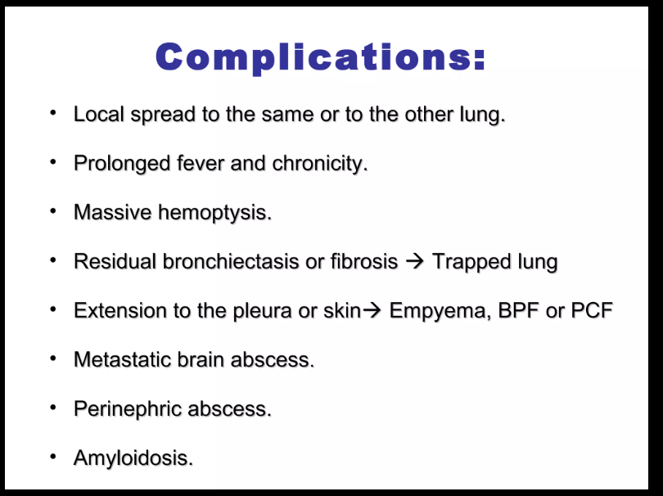

Slide 39
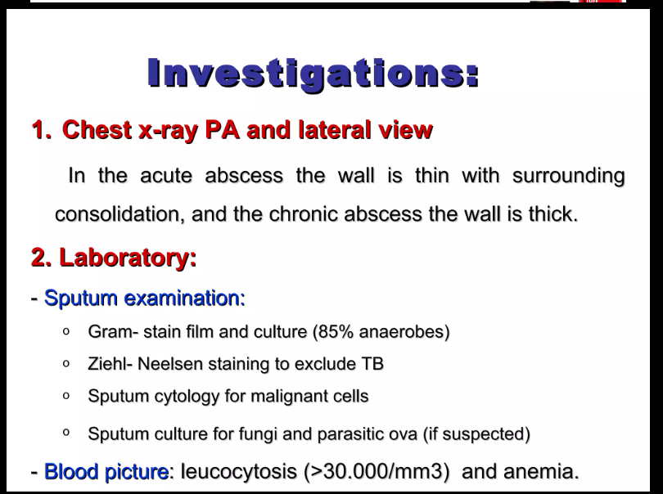

Slide 40
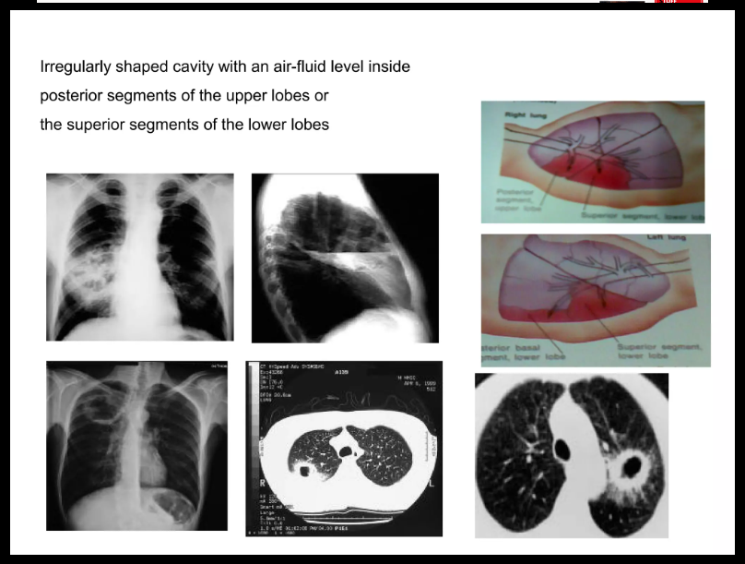

Slide 41
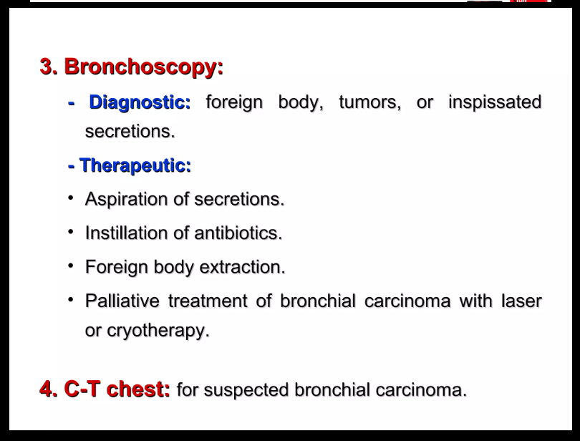

Slide 42
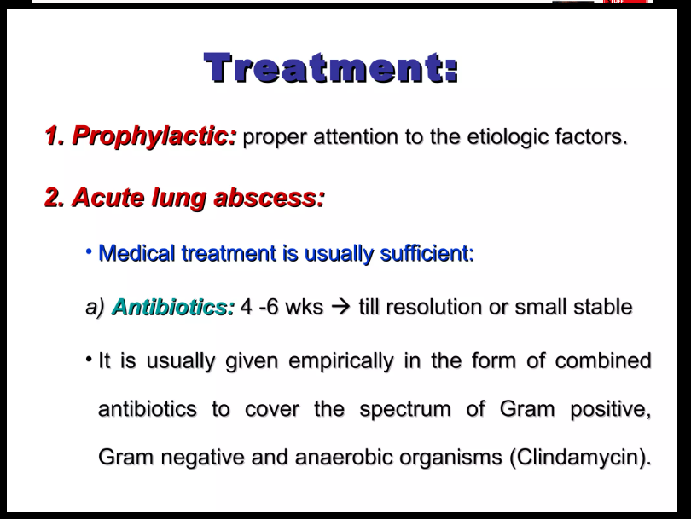

Slide 43
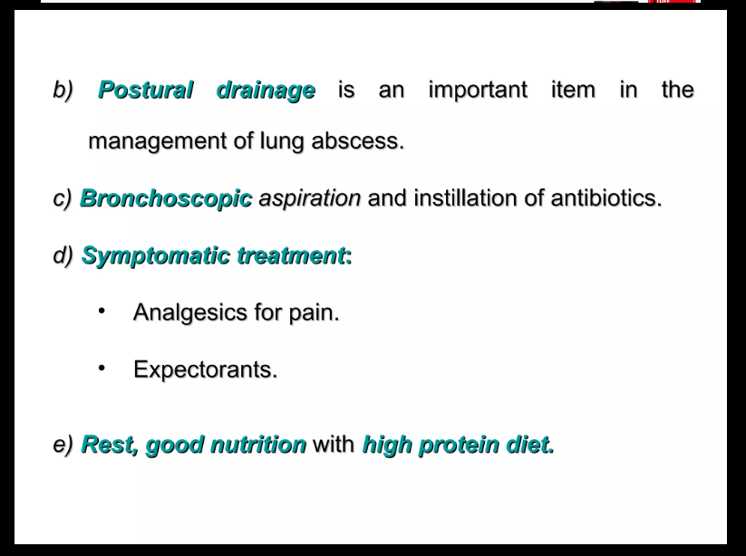

Slide 44
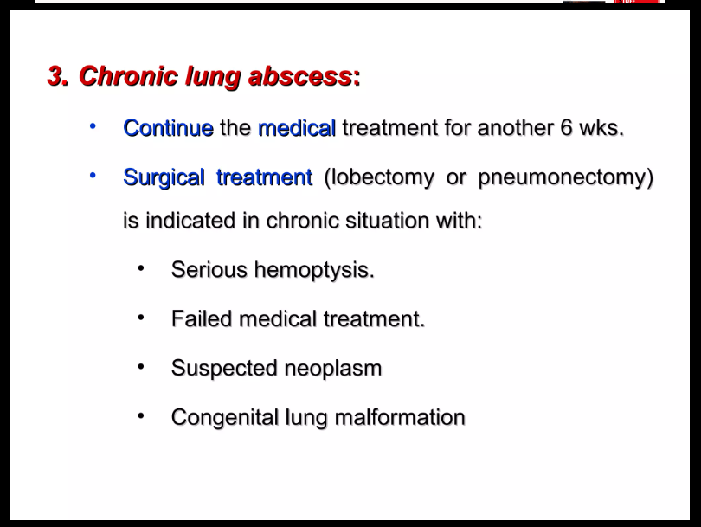

Slide 45
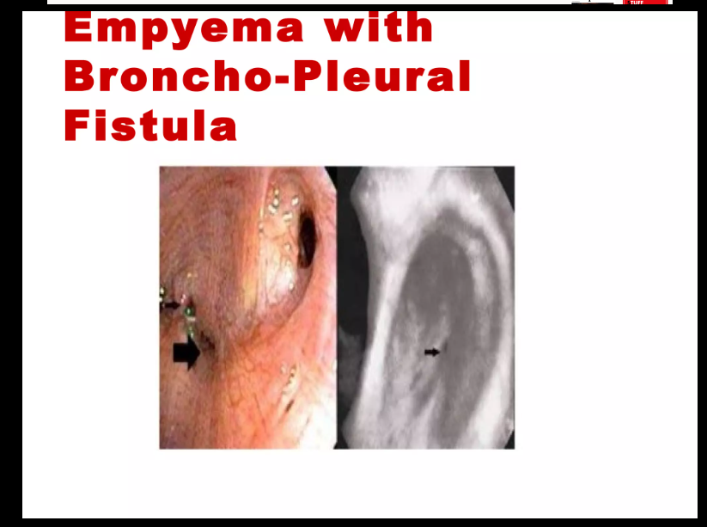

Slide 46
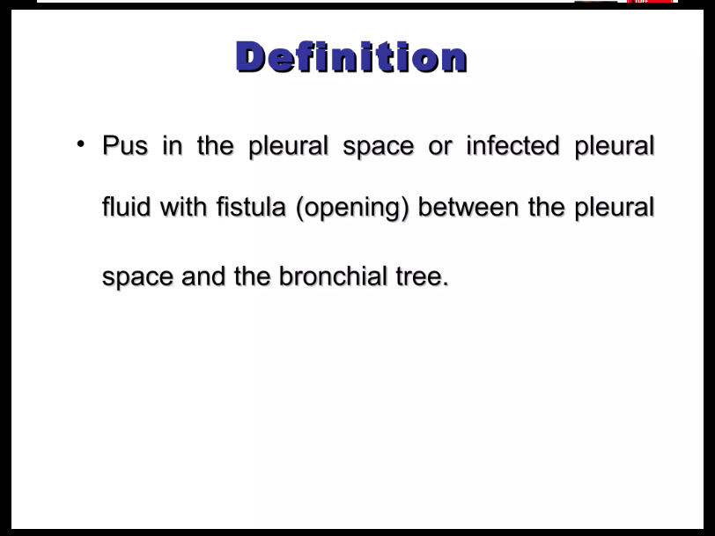

Slide 47
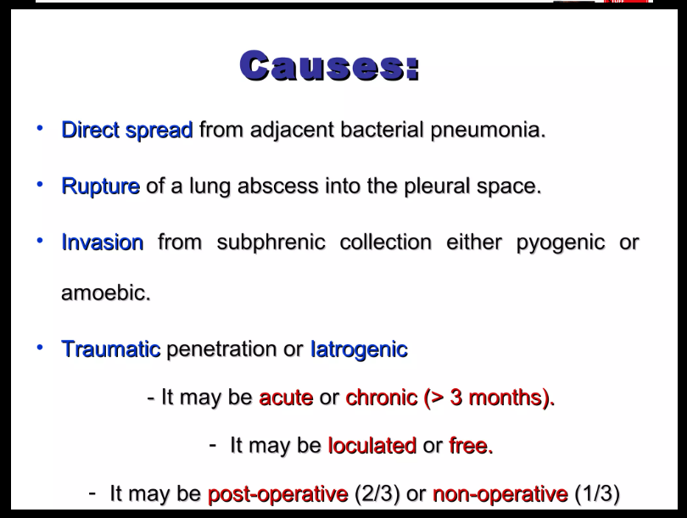

Slide 48
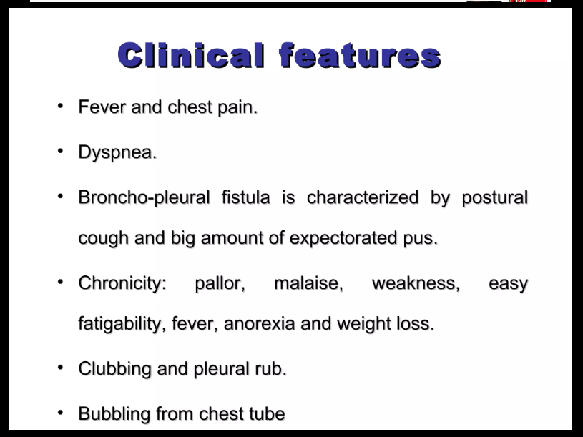

Slide 49
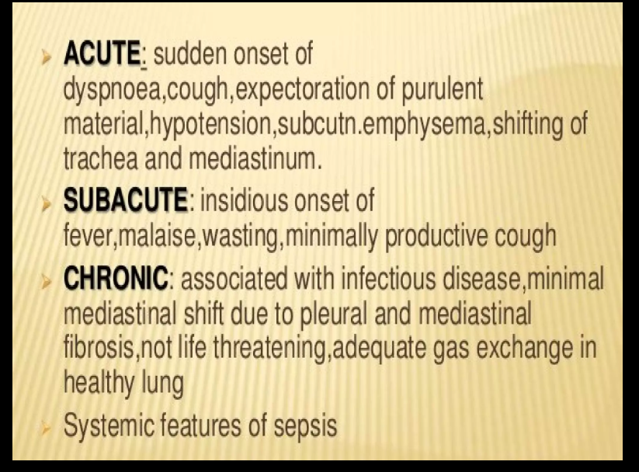

Slide 50
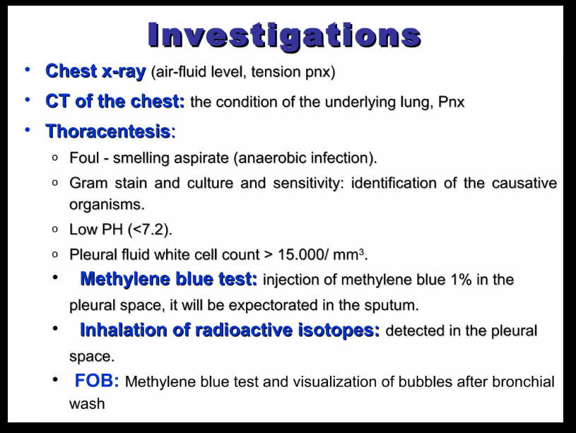

Slide 51
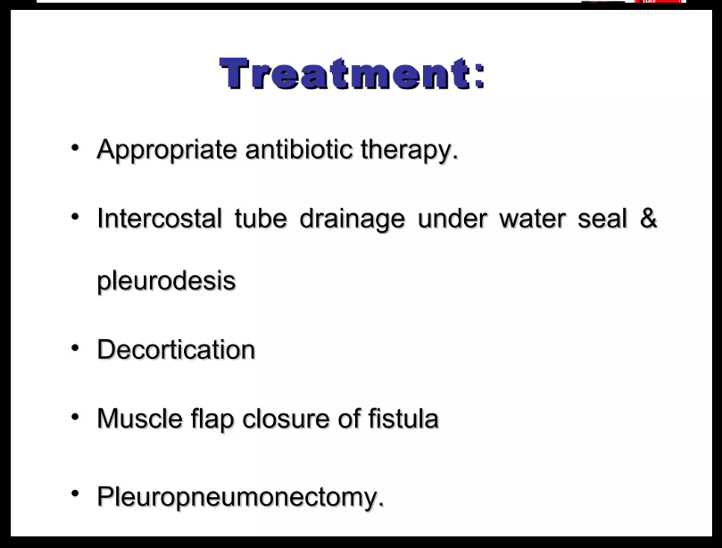

Slide 52
Case 1
☉Mr. K, male Patient, 25 years old, worker, no special habits.
Complaint: Cough with expectoration of (usually) large quantities of offensive, purulent sputum, increased on lying on his back, lasting months in the past 7 years.
☉Less frequently he has dyspnea, hemoptysis, fever,
weakness and weight loss in the last 2 years
☉There no relevant past or family history of similar condition, chronic sinusitis, GIT troubles.

Slide 53
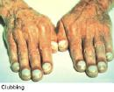
Physical Examination
▶ General findings: digital clubbing, pallor, wasting, and weight loss.
▶ Chest examination crackles and rhonchi, heard on auscultation bilaterally.
There is physical signs of cor pulmonale.

Slide 54
What is your provisional diagnosis?
  COPD
  Unresolved pneumonia
  Suppurative lung disease
  TB

Slide 55
What is your provisional diagnosis?
  COPD
  Unresolved pneumonia
  Suppurative lung disease
  TB

Slide 56
What is the most pathognomonic character in the history suggesting your diagnosis?
The sputum odor
Amount and color of the sputum
Postural relation of the sputum
Heamoptysis

Slide 57
What is the most pathognomonic character in the history suggesting your diagnosis?
The sputum odor
Amount and color of the sputum
Postural relation of the sputum
Heamoptysis

Slide 58
What is the significance of digital clubbing in this patient?
Presence of cor pulmonale
Presence of chronic hypoxemia
Presence of chronic toxemia
Persistent weight loss

Slide 59
What is the significance of digital clubbing in this patient?
Presence of cor pulmonale
Presence of chronic hypoxemia
Presence of chronic toxemia
Persistent weight loss

Slide 60
What do you suggest to support your diagnosis?
Sputum culture and sensitivity
Sputum analysis for acid fast bacilli
Pulmonary function tests
X ray chest and high resolution CT chest

Slide 61
What do you suggest to support your diagnosis?
Sputum culture and sensitivity
Sputum analysis for acid fast bacilli
Pulmonary function tests
X ray chest and high resolution CT chest

Slide 62
Laboratory Investigations
Tests include:
▶ Complete blood picture: anemia,
leucocytosis with increase in PMNL.
▶ Sputum microbiological tests gram stain
and culture is positive to Streptococci,
Anaerobic bacteroids.

Slide 63
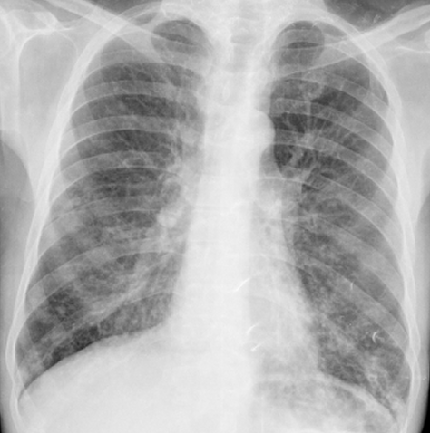
Chest X-Ray
► It shows thickened bronchial walls, multiple
cystic spaces
(Honeycombing)

Slide 64
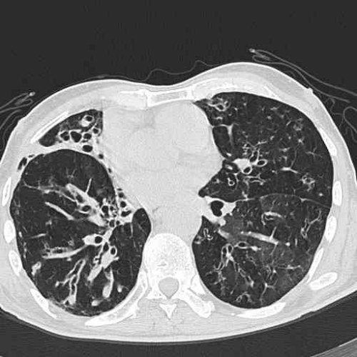
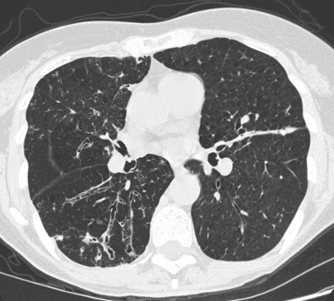
Chest Computed Tomography (CT)
► HRCT is characterized by dilated bronchi with thickened walls bilaterally.

Slide 65
What is your final diagnosis?
Post tuberculous bronchiectasis
Kartagner syndrome
Cystic fibrosis
Acquired bronchiectasis secondry to childhood infections

Slide 66
What is your final diagnosis?
Post tuberculous bronchiectasis
Kartagner syndrome
Cystic fibrosis
Acquired bronchiectasis secondry to childhood infections

Slide 67
Culture in bronchiectasis usually reveal the following organisms except:
◘ Streptococcus pneumoniae
◘ Staphylococcus aureus
◘ Haemophilus influenza
◘ Pseudomonas aeruginosa
◘ Mycobacterium TB

Slide 68
Sputum Culture in bronchiectasis may reveal the following organisms except:
◘ Streptococcus pneumoniae
◘ Staphylococcus aureus
◘ Haemophilus influenza
◘ Pseudomonas aeruginosa
◘ Mycobacterium TB
NB: Sputum is usually offensive due to
associated anaerobic infections e.g. Bacteroides

Slide 69
Pulmonary Function Tests in bronchiectasis may be?
▶ Non specific
▶ Limited diagnostic value
▶ Usually reveal an obstructive defect
with concomitant restrictive defect
▶ All of the above

Slide 70
Question 3, Pulmonary Function Tests in bronchiectasis may be?
▶ Non specific
▶ Limited diagnostic value
▶ Usually reveal an obstructive defect
with concomitant restrictive defect
▶ All of the above

Slide 71
Indications for resection for bronchiectasis include the following except:
1- Localized area (segment or lobe).
2- Severe or recurrent hemoptysis
3- Congenital bronchiectasis
4- Recurrent, severe episodes of infection

Slide 72
Indications for resection for bronchiectasis include the following except:
1- Localized area (segment or lobe).
2- Severe or recurrent hemoptysis
3- Congenital bronchiectasis
4- Recurrent, severe episodes of infection

Slide 73


Slide 74
Case 2
A 16 years old male patients, student, single with no special habits.
The patient has history of progressive dyspnea since childhood, cough and expectoration of large amount of yellow green sputum increased on lying on his back
Past history of repeated chest infections, pneumothorax.
No past history of TB, allergy, previous operations or GIT symptoms

Slide 75
General examination
The patients looks ill, underweight, pale
Finger nail clubbing
Cardiac and abdominal examinations are free
Mild lower limb edema
Chest examination;
  Bilateral medium sized to coarse crepitations all over the chest, scattered sonorous rhonchi.

Slide 76
Based on the history, and examination the patient may have the following except
Congenital bronchiectasis
Kartagner syndrome
Infected cystic lung
hypogammaglobulinemia

Slide 77
Based on the history, and examination the patient may have the following except
Cystic fibrosis
Kartagner syndrome
Infected cystic lung
hypogammaglobulinemia

Slide 78
How would you explain the lower limb edema in this patient?
Cor pulmonale
Nephrotic syndrome
Liver cirrhosis
Hypoproteinemia

Slide 79
How would you explain the lower limb edema in this patient?
Cor pulmonale
Nephrotic syndrome
Liver cirrhosis
Hypoproteinemia

Slide 80
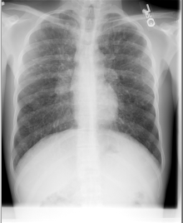

22/yo male with cystic fibrosis
X ray chest
Diffuse bilateral air spaces ( soap bubble appearance)

Slide 81

CT chest bilateral thin walled cystic spaces in middle lobe and lingula

Slide 82
Investigations
Complete blood picture shows leucocytosis, mild anemia.
ESR 23/39
Echocardiography and abdominal sonography are free

Slide 83
The main line of management of this case of infected cystic lung?
Surgery
Antibiotics
Postural drainage
Both postural drainage and antibiotic

Slide 84
The main line of management of this case of infected cystic lung
Surgery
Antibiotics
Postural drainage
Both postural drainage and antibiotic

Slide 85
Infected cystic lung
(Congenital cystic adenomatoid malformation of the lung)
Infection
Bronchial
Obstruction
Inflammation
Bronchiectasis

Slide 86
Vicious loop
Antibiotics
Infection
Bronchial
Obstruction
Inflammation
Very rarely: Anti-inflammatory
Clearance
bronchodilators, DNase,
Therapy vest
Bronchiectasis

Slide 87
Case 3

Slide 88
Complaint
► Female patient, 33 years old, house wife no special habits.
► History of fever, cough and expectoration of a big amount of sputum after upper abdominal operation (since 3 months).
► Sputum is usually purulent and foul odor.

Slide 89

Clinical examination
Patient looks ill and feverish
Clubbing
Clinical signs of consolidation e.g. bronchial breathing and crepitations in the left infra-scapular area

Slide 90
Investigations
► Blood picture: increase in white cell count
► Sputum examination: mixed gram positive, negative and anaerobic organisms
sensitive to different antibiotics.
► ESR 45/58

Slide 91


Plain X ray and CT chest
Chest X-ray: reveals rounded cavity with fluid level.
Computed tomography demonstrates the rounded cavity with regular thickened wall and air fluid level in the LLL

Slide 92
What is your provisional diagnosis?
Sequestrated lobe
Loculated empyema
Lung abscess
Unresolved pneumonia

Slide 93
What is your provisional diagnosis
Sequestrated lobe
Loculated empyema
Lung abscess
Unresolved pneumonia

Slide 94
Commonest cause of lung abscess is?
  1- Aspiration
  2- Post-traumatic lung abscess
  3- Malignant lung abscess
  4- Septic pulmonary embolization
  5- Amoebic lung abscess

Slide 95
Commonest cause of lung abscess is?
  1- Aspiration
  2- Post-traumatic lung abscess
  3- Malignant lung abscess
  4- Septic pulmonary embolization
  5- Amoebic lung abscess

Slide 96
These micro organisms may be recovered by culture from lung abscess except
TB bacilli
Respiratory syncetial virus
Klebsiella pneumonea
Anaerobic, peptostreptococcus bacteroids

Slide 97
These micro organisms may be recovered by culture from lung abscess except
TB bacilli
Respiratory syncetial virus
Klebsiella pneumonea
Anaerobic, peptostreptococcus bacteroids

Slide 98
Bronchoscopy in patients with suspected lung abscess is indicated in the following except:
1-When there is suspicion of foreign body inhalation
2- Endo-bronchial tumor
3- Tuberculosis
4- Installation of antibiotics

Slide 99
Bronchoscopy in patients with suspected lung abscess is indicated in the following except:
1- When there is suspicion of foreign body inhalation
2- Endo-bronchial tumor
3- Tuberculosis
4- Installation of antibiotics

Slide 100
Surgery is indicated in cases of lung abscess if:
Failure of medical treatment
Suspected foreign body
Presence of bronchial adenoma
All of the above

Slide 101
Surgery is indicated in cases of lung abscess if
Failure of medical treatment
Suspected foreign body
Presence of bronchial adenoma
All of the above

Slide 102
Case 4

Slide 103
Clinical Picture
► Male patient 17 years old, student with no special habits.
► The patient has history of pneumonia with prolonged and recurrent fever, chest pain since 2 months.
►2 weeks ago, the patient developed severe pleuretic chest pain on the left side, cough with big amount of expectorated pus increase on lying on the right.

Slide 104
Clinical examination
► Dyspnea
► High pyrexia with rigors, anemia, pallor, malaise
► Pleural pain and persistent cough
► Clinical signs of left sided pleural effusion ( with shifting dullness)

Slide 105


1- Chest X-ray and CT Chest
► pleural effusion ( with fluid level).
► CT chest: left sided hydropneumothorax.

Slide 106
Investigations
2- Thoracentesis (Pleural taping)
►The pleural aspirate is purulent, foul-smelling.
►The pleural aspirate analyzed for the following:
gram stain shows: mixed organisms, with positive
aerobic and anaerobic cultures.
pH is usually low (<7.2)
Pleural fluid white cell count > 15.000/ml

Slide 107
3- Laboratory investigations
- PMN leucocytosis
High ESR
High C-reactive protein (CRP)

Slide 108
What is your provisional diagnosis?
Bronchiectasis
Lung abscess
Empyema with broncho-pleural fistula
Infected cystic lung

Slide 109
What is your provisional diagnosis?
Bronchiectasis
Lung abscess
Empyema with broncho-pleural fistula
Infected cystic lung

Slide 110
What is the diagnostic test for this case?
X ray chest
High resolution CT
Methylene blue test
Chest sonography

Slide 111
What is the diagnostic test for this case?
X ray chest
High resolution CT
Methylene blue test
Chest sonography

Slide 112
Indication of Ultrasound of the chest in this case is to define:
Extent of pleural thickening
Location of the fluid (general or loculated)
To guide pleuracentesis (pleural tapping)
All of the above

Slide 113
Indication of Ultrasound of the chest is to define:
Extent of pleural thickening
Location of the fluid (general or loculated)
To guide pleuracentesis (pleural tapping)
All of the above

Slide 114
The main line of treatment of empyema with bronchopleural fistula is?
Drainage of empyema
Use of antibiotic
Fibrinolytic therapy
Repair of the fistula

Slide 115
The main line of treatment of empyema with bronchopleural fistula is?
Drainage of empyema
Use of antibiotic
Fibrinolytic therapy
Repair of the fistula

Slide 116
Empyema with BP fistula
Definition
It is pus in the pleural space or infected pleural fluid with fistula.
The causative organism may or may not be
isolated from the pus.
Microscopically, neutrophil leucocytes are present in large number (>15. 000/ml).

Slide 117
Diagnosis of Bronchopleural Fistula
Injection of 1% of methylene blue in the pleural
cavity and to look for the blue dye in the sputum.
Pleural biopsy
May be needed to differentiate between
tuberculous and non-tuberculous infections

Slide 118
Treatment
► Thoracentesis for easily aspirated pus by wide
bored needle.
► Intercostal chest tube under water-seal
drainage with initial antibiotic therapy till
culture and sensitivity are available.
► Use of antibiotic for 2-4 weeks.
► Metronidazole with penicillin for anaerobic infection
Anti-tuberculous treatment for tuberculous empyema.

Slide 119
Empyema with BP fistula
Treatment
Surgery
► Cutting the pleural adhesions and freeing
the loculi for optimal drainage
► Decortication for thickened pleura
► Surgical closure of bronchopleural fistula
Via Thoracotomy or Video-Assisted Thoracoscopic Surgery
(VATS)

Slide 120
THANK YOU

